Slide 1
12 Operator Overloading
Dandan Song
Beijing Institute of Technology

Slide 2
Function Overloading
Different functions have the same name (polymorphism)
In C++, a function is identified not only by the name, but also by the number and the types of its parameters and the keyword, (const).

Slide 3
Function Overloading-Examples
void swap (unsigned long &, unsigned long &);
void swap (double &, double &);
void swap (char &, char &);
void swap (Point &, Point &);
They are different functions!
Functions with the same name should have similar function.

Slide 4
Why operators need overloading ?
class complex
{
public:
complex(double x = 0, double y = 0)
{ re = x; im = y; }
complex Add(complex& c)
{
double t1 = re+c.re;
double t2= im+c.im;
return complex(t1,t2);
}
private:
double re, im;
};
void main()
{
complex c, c1, c2(5.5, 2);
c = c1.Add(c2);
}
In fact, we hope to write it like this:
c = c1 + c2;
Use Operator Overloading

Slide 5
12.1 Warning & reassurance
Operator overloading is another way of calling a function.
It is for the code involving your class easier to write and especially easier to read.
All the operators used in expressions that contain only built-in data types cannot be changed. Only an expression containing a user-defined type can have an overloaded operator.

Slide 6
12.2 Syntax
The name of an operator function is the keyword operator followed by the operator itself.
type operator @ (argument list)
{
// code realization
}

Slide 7
Defining an overloaded operator is like defining a function, but the name of that function is operator@, in which @ represents the operator that’s being overloaded.
The number of arguments in the overloaded operator’s argument list depends on two factors:
  unary (one operand) or binary (two operands).
  global function (one argument for unary, two for binary) or member function (zero arguments for unary, one for binary).

Slide 8
//: C12:OperatorOverloadingSyntax.cpp
#include <iostream>
using namespace std;
class Integer
{
int i;
public:
Integer(int ii) : i(ii) {}
void print( ){ cout<<i<<endl; }
const Integer operator+(const Integer& rv) const;
};
const Integer Integer::operator+(const Integer& rv) const
{
return Integer(i + rv.i);
}
void main()
{
int i = 1, j = 2, k = 0;
k = i + j;
Integer ii(1), jj(2), kk(0);
kk = ii + jj;
kk.print(); // 3
} ///:~

Slide 9
It is not possible to define new operator tokens, but you can use the function-call notation when the set of operators is not adequate.
The operators = (assignment), & (address-of) and , (sequencing) have predefined meanings when applied to class objects.

Slide 10
12.3 Overloadable operators
Unary Operators
  new, delete, new[ ], delete[ ],
  ++, --, (), [ ], +, -, *, &, !, ~,
Binary operators
  +, -, *, /, %, =, +=, -=, *=, /=, %=,
  &, |, ^, ^=, &=, |=, ==, !=, >, <, >=,
  <=, ||, &&, <<, >>, >>=, <<=, ->, ->*

Slide 11
member functions
non-member friend functions

Slide 12
Member functions
Format:
type operator @ (arguments) {/*…*/}
Usage:
Prefix Unary: @a a.operator @( )
Postfix Unary: a@ a.operator @(int)
Binary: a@b a.operator @(b)
Notice the implicit this.
- Prefix unary: no argument;
- Postfix unary: only one integral argument;
- Binary: only one argument acts as its right operand and this implies its left operand.

Slide 13
// complex.h ; member functions
class complex
{
public:
complex (double r=0,double i=0);
const complex operator+(const complex& c); // Binary
const complex operator-(); // Prefix unary
complex& operator+=(const complex& c);//Binary,assign
void print() const;
private:
double real, imag;
};

Slide 14
//complex.cpp ; member functions
# include <iostream>
# include "complex.h”
using namespace std;
complex::complex (double r, double i)
{
real=r;
imag=i;
}
const complex complex::operator +(const complex& c)
{
double r=real+c.real;
double i=imag+c.imag;
return complex(r,i);
}

Slide 15
//complex.cpp --continued
const complex complex::operator -()
{
return complex(-real,-imag);
}
complex& complex::operator+=(const complex& c)
{
real=real+c.real;
imag=imag+c.imag;
return *this;
}
void complex::print() const
{
cout<<"(" <<real<<", "<<imag<<") "<<endl;
}

Slide 16
//user.cpp ; member functions
void main()
{
complex c1(3.5,5.5),c2(1.5,3.5);
complex c;
c=c1+c2;
c.print();
c+=c1+=c2;
c.print();
c=-c1;
c.print();
}
( 5, 9 )
( 10, 18 )
( -5, -9 )
c=c1.operator+(c2);// member
c1.operator+=(c2);
c.operator+=(c1);
c=c1.operator-();

Slide 17
Friend functions
Format:
friend type operator @ (arguments) {/*…*/}
Usage:
Prefix Unary: @a operator @(a)
Postfix Unary: a@ operator @(a, int)
Binary: a@b operator @(a, b)
Notice: there is no implicit this.

Slide 18
// complex.h ; friend functions
class complex
{
public:
complex (double r=0,double i=0);
friend const complex operator +
(const complex& c1, const complex& c2); // Binary
friend const complex operator -(const complex& c);
// Prefix unary
friend complex& operator+=
(complex& c1, const complex& c2);//Binary,assign
void print() const;
private:
double real, imag;
};

Slide 19
//complex.cpp ; friend functions
# include <iostream.h>
# include "complex.h "
complex::complex (double r, double i)
{
real=r;
imag=i;
}
// not member
const complex operator +
(const complex& c1, const complex& c2)
{
double r=c1.real+c2.real;
double i=c1.imag+c2.imag;
return complex(r,i);
}

Slide 20
//complex.cpp --continued
const complex operator -(const complex& c)
{
return complex(-c.real,-c.imag);
}
complex& operator+=(complex& c1, const complex& c2)
{
c1.real+=c2.real;
c1.imag+=c2.imag;
return c1;
}
void complex::print() const
{
cout<<"(" <<real<<", "<<imag<<")"<<endl;
}

Slide 21
//user.cpp ; friend functions
void main()
{
complex c1(3.5,5.5),c2(1.5,3.5);
complex c;
c=c1+c2;
c.print();
c+=c1+=c2;
c.print();
c=-c1;
c.print();
}
( 5, 9 )
( 10, 18 )
( -5, -9 )
c=operator+(c1, c2);
operator+=(c1, c2); // not member
operator+=(c, c1);
c=operator-(c1);

Slide 22
Operators & ordinary functions
Operator functions are declared and called like ordinary functions.
Operator functions can be with 1 or 2 arguments, but ordinary functions can have several arguments.
An operator function must either be a member or take at least one argument of a user-defined type.

Slide 23
12.3 Overloadable operators
12.3.1 Unary operators: P489-493
  +, -, &, !, ~, ++, --
12.3.2 Binary operators: P494-504
  =, +, -, *, /, %, +=, -=, *=, /=,
  %=, &, |, ^, ^=, &=, |=, ==, !=, >,
  <, >=, <=, ||, &&, <<, >>, >>=, <<=

Slide 24
12.3.3 Arguments & return values
As with any function argument, if you only need to read from the argument and not change it, default to passing it as a const reference.
The type of return value you should select depends on the expected meaning of the operator. (operator+, returning a const value--the sum of two operands)
All the assignment operators modify the lvalue, returning a nonconst reference. a+=b
For the logical operators, everyone expects to get at worst an int back, and at best a bool.

Slide 25
//member functions
const complex complex::operator +(const complex& c)
{
double r=real+c.real;
double i=imag+c.imag;
return complex(r,i);
}
complex& complex::operator+=(const complex& c)
{
real=real+c.real;
imag=imag+c.imag;
return *this;
}
(a+b) Return by value as a const:
f(a+b): the result of a+b becomes a temporary const object that is used when calling f( ).
(a+b).g( ): By making the return value const, it means only a const member function can be called.

Slide 26
Constructor.
Destructor.
main() End.
#include <iostream>
using namespace std;
class A {
int i;
public:
A(int x=0) {i=x; cout<<"Constructor."<<endl;}
A(const A& x){i=x.i; cout<<"Copy constructor."<<endl;}
~A() {cout<<"Destructor."<<endl;}
};
A f( ){ return A(1);}
void main()
{
f();
cout<<"main() End."<<endl;
}
Constructor.
Copy Constructor.
Destructor.
Destructor.
main() End.
A f()
{
A a(1);
return a;
}

Slide 27
Advice
If the first operand is an object of an class, the operator should be declared as a member function. Otherwise, it should be declared as a friend function.

Slide 28
Example-problem
class complex
{
public:
complex (double r=0,double i=0)
{
real=r;
imag=i;
}
const complex operator +(const complex& c);
void print() const
{ cout<<" (" <<real<<", "<<imag<<") "<<endl; }
private:
double real, imag;
};

Slide 29
Example-problem
const complex complex::operator +(const complex& c)
{
double r=real+c.real;
double i=imag+c.imag;
return complex(r,i);
}
void main()
{
complex c, c1(3.5, 5.5);
c=c1+1.5; // ok: c=c1.operator +(1.5);
c.print(); // (5, 5.5)
c=1.5+c1; //error: c=1.5.operator +(c1);
}

Slide 30
Example-ok
class complex
{
public:
complex (double r=0,double i=0)
{
real=r;
imag=i;
}
friend const complex operator +
(const complex& c1, const complex& c2); // Binary
void print() const
{ cout<<“( ” <<real<<“, ”<<imag<<“)”<<endl; }
private:
double real, imag;
};

Slide 31
Example-ok
const complex operator +(const complex& c1, const complex& c2)
{
double r= c1. real+c2.real;
double i= c1. imag+c2.imag;
return complex(r,i);
}
void main()
{
complex c, c1(3.5, 5.5);
c=c1+1.5; // ok: c=operator +(c1, 1.5);
c.print(); // (5, 5.5)
c=1.5+c1; //ok: c=operator +(1.5, c1);
c.print(); // (5, 5.5)
}

Slide 32
class X
{
public:
void operator+(int);
X(int);
};
void operator+(X,X);
void operator+(X,double);
void f(X a)
{
a+1; // a.operator+(1)
1+a; // ::operator+(X(1),a)
a+1.0; // ::operator+(a,1.0)
}

Slide 33
12.3.4 Special operators
Subscripting: [ ]
Operator ,
Dereferencing: →
The operator–>*
Increment and Decrement: ++,--
Assignment: =
Conversion
<<, >>

Slide 34
(1) Subscripting
The operator [ ] can be overloaded for a class.
Note: It must be overloaded as a member function.

Slide 35
#include <iostream>
using namespace std;
class vect
{
public:
vect(int size) {v=new int[size];}
~vect() {delete[] v;}
int& operator [](int i); //member function
private:
int *v;
};
int& vect::operator []( int i )
{ cout<<"Subscripting"<<endl; return v[i]; }
void main()
{
vect a(5);
a[2]=12; // a.operator[](2)=12;
cout<<a[2]<<endl; // a.operator[](2);
}
Subscripting
Subscripting
12

Slide 36
(2) Operator comma
Operator ,
There doesn’t seem to be a lot of practical uses for this operator.

Slide 37
(3) Dereferencing: ->
The operator -> must be overloaded as a member function.
The function should return a pointer to a class.

Slide 38
struct Student
{ int age;
int ID; };
class X
{
public:
X() { S = new Student; S->age = 0; S->ID = 0; }
Student* operator ->() { return S; }
~X() { delete S; }
public:
Student *S;
};
void main()
{
X x;
x->age = 20; // (x.operator->()) ->age = 20;
x->ID = 001; // (x.operator->()) ->ID = 001;
}

Slide 39
(4) Operator->*
The operator–>* is a binary operator.
pointer-to-member

Slide 40
(5) Increment and Decrement
The increment(++) and decrement(--) operators can be used as both prefix and postfix operators. For example:
int x = 10; x++; ++x;
int x = 10; x--; --x;
So if we overload these two operators, we should give four operator functions.
Generally they are overloaded as member functions.

Slide 41
Increment and Decrement
Syntax of increment overloading is as follows:
Prefix: type operator++()
Postfix: type operator++(int)
Prefix: type operator-- ()
Postfix: type operator-- (int)
The int argument is used to indicate that the function is to be invoked for postfix application of ++ or --. This int is never used; the argument is simply a dummy used to distinguish between prefix and postfix application.

Slide 42
#include<iostream>
using namespace std;
class Increase
{
public :
Increase (int val=0 ) { value=val; }
void display( ) const { cout << value << endl; }
Increase operator ++( ) ; // prefix
Increase operator ++( int ) ; // postfix
private:
int value ;
};
Increase Increase :: operator++( ) // prefix
{
cout<<"++value"<<endl;
++value;
return *this;
}

Slide 43
Increase Increase :: operator++( int ) // postfix
{
cout<<"value++"<<endl;
int temp=value;
value++;
return Increase(temp);
}
void main( )
{
Increase a(10),b(10),c;
c=++a; // a.operator++();
c.display( );
c=b++; // b.operator++(int);
c.display( );
}
++value
11
value++
10

Slide 44
(6) Assignment: =
(7) Conversion
(8) <<, >>

Slide 45
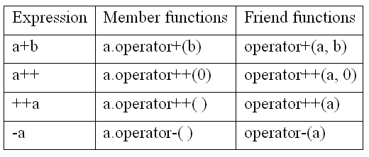

Slide 46
12.3.5 Operators you can’t overload
. member selection
.* member selection by a pointer
:: scope resolution
?: ternary conditional expression
sizeof
Typeid
There’s no exponentiation operator.
There are no new user-defined operators.
You can’t change the precedence rules.

Slide 47
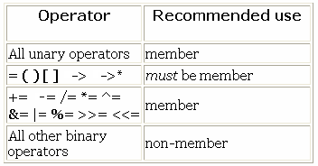
12.4 members or non-member ?
Which should you choose, members or non-member ?

Slide 48
12.5 Overloading assignment
Syntax of assignment overloading is as follows:
X& X :: operator = ( const X& from)
{
// copy data from the argument
}

Slide 49
Date t1; // constructor
Date t2=t1; //copy constructor
Date t3; // constructor
t3=t2; // assignment operator
The aim: a created class object can be updated with a copy of another created object of the same class.
If a user has declared a assignment operator, it will be used; if not, the compiler will try to generate public one.

Slide 50
class Location
{
public:
Location(int xx=0,int yy=0) {X=xx;Y=yy;} //default constructor
Location(const Location &p) //copy constructor
{ X=p.X; Y=p.Y;
cout<<“Copy constructor called.”<<endl;
}
Location& operator =(const Location& p); //assignment
int GetX() {return X;}
int GetY() {return Y;}
private:
int X,Y;
};
Location& Location::operator =(const Location& p)
{ X=p.X;
Y=p.Y;
cout<<"Assignment operator called."<<endl;
return *this;
}

Slide 51
void main()
{
Location A(1,2), B;
B=A;
cout<<"B="<<B.GetX()<<","<<B.GetY()<<endl;
};
Assignment operator called.
B=1,2
void main()
{
Location A(1,2);
Location B=A;
cout<<"B="<<B.GetX()<<","<<B.GetY()<<endl;
};
Copy constructor called.
B=1,2

Slide 52
When overloading a operator, we cannot change :
- number of operands
- priority
- structure of syntax
- combination
For build-in types, a=a+1 is equivalent to a+=1, which is not for user-defined types unless you happen to define them that way. A compiler will not generate X::operator+=() from the definitions of X::operator+() and X::operator=().

Slide 53
User-defined Copy Constructor and Assignment Operator
A copy constructor and an assignment operator must be defined when used on objects of a class with pointer members.
Otherwise, it may cause a surprising (and usually undesired) effect.

Slide 54
class A
{
int *p;
public:
A(int i) { p=new int( i ); }
~A() { delete p; }
};

Slide 55
a.p and b.p point to the same storage.
The storage(5) will be released twice.
void main()
{
A a(5);
A b(a); //copy constructor
A c(6),d(10);
d=c; //assignment operator
};
c.p and d.p point to the same storage.
The storage(6) will be released twice.
The storage(10) is lost forever.
c.p
d.p
a.p
b.p
6
5
d.p
10

Slide 56
modification
class A {
int *p;
public:
A(int i) { p=new int( i ); }
~A() { delete p; }
A(const A& r); //copy consructor
A& operator =(const A& r); //assignment
};
A::A(const A& r){ p=new int(*r.p); }//copy consructor
A& A::operator =(const A& r) //assignment
{
if (this==&r) return *this; // self-assignment: r=r
delete p;
p=new int(*r.p);
return *this;
}

Slide 57
void main()
{
A a(5);
A b(a); //copy constructor
A c(6),d(10);
d=c; //assignment operator
}
c.p
a.p
6
5
d.p
b.p
d.p
10
5
6

Slide 58
example
class A
{
int *p;
public:
A(int i) { cout << "Constructor" << endl; p=new int(i); }
~A() { cout << "Destructor" << endl; delete p; }
A(const A& r) //copy consructor
{ cout << "Copy-constructor" << endl; p=new int(*r.p); }
A& operator =(const A& r); //assignment
void output() { cout << p << "->" << *p << endl; }
};
A& A::operator =(const A& r) //assignment
{
cout << "Assignment" << endl;
if (this==&r) return *this; // self-assignment: r=r
delete p;
p=new int(*r.p);
return *this;
}

Slide 59
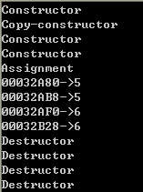
int main()
{
A a(5);
A b(a); //copy consructor
A c(6), d(10);
d=c; //assignment
a.output();
b.output();
c.output();
d.output();
return 0;
}

Slide 60
12.6 Automatic type conversion
A constructor can be used to specify type conversion.
The second way to produce automatic type conversion is through operator overloading.

Slide 61
12.6.1 Constructor conversion
#include <iostream>
class complex
{
public:
complex (double r=0,double i=0);
complex (const complex& a);
friend const complex operator +
(const complex& c1, const complex& c2);
private:
double real, imag;
};

Slide 62
complex::complex (double r,double i)
{
real=r;
imag=i;
cout<<"constructor:"<<real<<","<<imag<<endl;
}
complex::complex (const complex& a)
{
real=a.real;
imag=a.imag;
cout<<"copy constructor:"<<real<<","<<imag<<endl;
}

Slide 63

const complex operator +
(const complex& c1, const complex& c2)
{
double r= c1. real+c2.real;
double i= c1. imag+c2.imag;
return complex(r,i); //
}
void main()
{
complex c, c1(3.5, 5.5);
c=c1+1.5; // ok: c=operator +(c1, complex(1.5));
}
c
c1
double-->complex
return complex(r,i);

Slide 64
12.6.2 Conversion Operators
A constructor cannot specify:
-- an implicit conversion from a user-defined type to a basic type.
-- a conversion from a new class to a previously defined class (without modifying the declaration for the old class).
Conversion operator:
X::operator T( )
  defines a conversion from X to T.
  Note that the type being converted to is part of the name of the operator and cannot be repeated as the return value of the conversion function.

Slide 65
#include <iostream>
using namespace std;
class complex
{
double real, imag;
public:
complex (double r=0,double i=0)
{
real=r;
imag=i;
cout<<"(" <<real<<", "<<imag<<")"<<endl;
}
operator int ( ){return int(real);} // complex to int
};
void main()
{
complex c(3.5, 5.5);
cout<<int(c)<<endl;
}
(3.5, 5.5)
3

Slide 66
12.7 Overloading << and >>
《C++程序设计》, 赵清杰主编, 清华大学出版社 2008

Slide 67
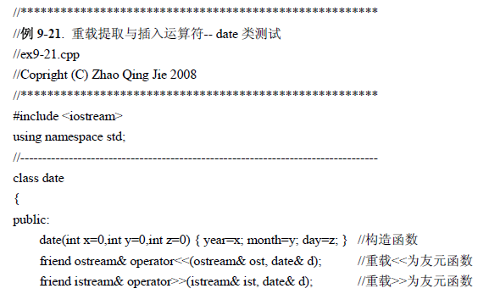


Slide 68
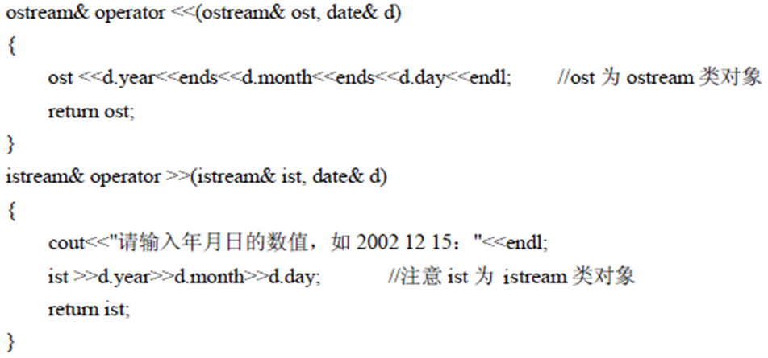
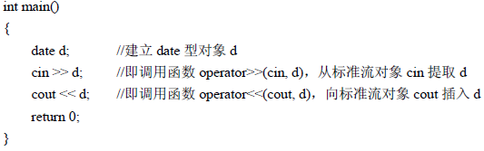

Slide 69
Summary
Introduction：
    The name of an operator function
    Unary, binary, ternary
    Operators allowing overloaded
    Operators not allowing overloaded
Overloading as：
    Member functions
    Friend functions
Special Operators：
[ ], ++, --, =, Conversion, <<, >>

Slide 70
Exercises
P570: 11,12,14

